Slide 1
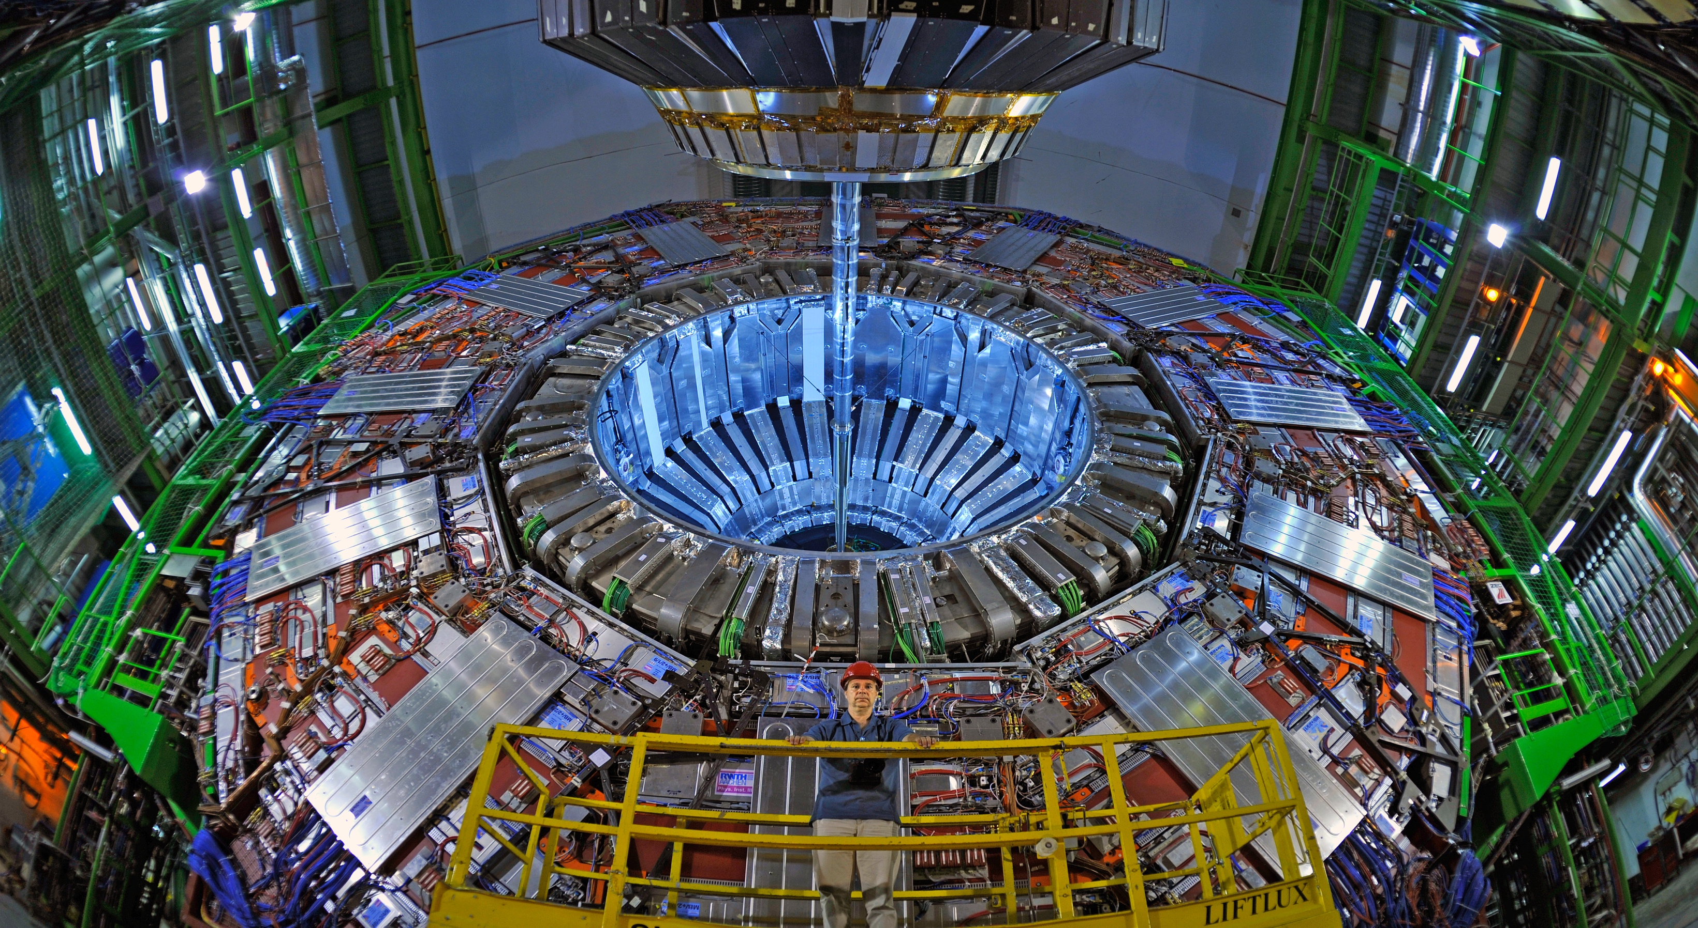
Searching beyond the Standard Model at the LHC
Kevin Stenson
Halloween, 2018
Funding through DOE:
DE-FG02-13ER41921

Slide 2
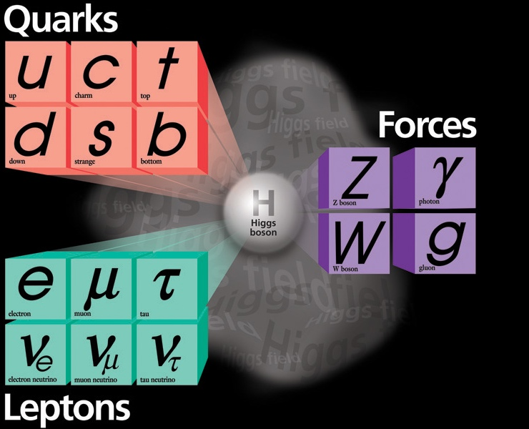
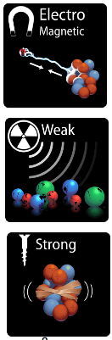
The Standard Model of particle physics (SM)
With the announcement of the Higgs boson discovery on July 4, 2012, all Standard Model particles have been observed.

Slide 3
But still lots of questions…
How come the Higgs boson mass is so light?
What is the source of dark matter?
What is the nature of dark energy?
What happened to all the antimatter in the universe?
Why are there 3 generations of quarks and leptons?
How do neutrinos get their mass?
Are neutrinos Dirac or Majorana particles?
Is there a Grand Unified Theory (and can we reduce the 26 parameters of the SM)?
Are baryon and lepton number really conserved does the proton decay)?
Why no CP violation in strong interactions?
What is the quantum theory of gravity?

Slide 4
Why is the Higgs boson so light?
The SM is known to work up to an energy of ~1 TeV.
It is expected to break down before the Planck scale (10¹⁶ TeV) where quantum gravity should appear.
So the SM cutoff scale, labeled Λ, should be <10¹⁶ TeV
Quantum corrections to the Higgs mass in the SM contain should result in a mass near Λ. So it is strange to find it at 0.1 TeV.
Solutions to the hierarchy problem:
  The SM is only valid to ~1 TeV and there is a new theory above ~1 TeV.
  There is a fine tuning of the quantum corrections at the level of 1 part in 10¹⁶ (actually 1 part in 10³² since they are quadratic).

Slide 5
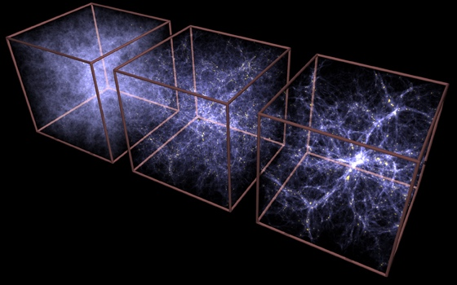
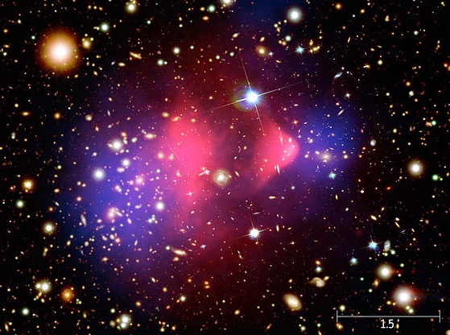
Evidence for dark matter
Galactic rotation curves indicate invisible matter in a spherical halo.
Cosmic microwave background finds more than normal matter.
Gravitational lensing of Bullet Cluster shows dark matter behaves differently than ordinary matter.
Large scale structure of the universe only makes sense with dark matter.

Slide 6
Many dark matter possibilities
Axions: light particles with little interaction with normal matter; originally proposed to explain lack of CP violation in strong force.
Dark sector: Particles with non-Standard Model interactions.
WIMPs: Weakly Interacting Massive Particles with mass 0.01–10 TeV that interact via weak force.
Sterile neutrinos: ~keV mass, no coupling to W/Z.

Slide 7
WIMPs seem to be an ideal solution
During Big Bang, universe is cooling and expanding.
When T>M_{χ}, the number density of χ particles is constant as creation and annihilation is in equilibrium.
When T<M_{χ}, density drops off exponentially (Boltzman).
As universe expands, particles can’t find each other to annihilate: “freeze-out”.
The cross section needed to get the correct amount of dark matter is ~ weak interaction. Called the “WIMP miracle”.

Slide 8
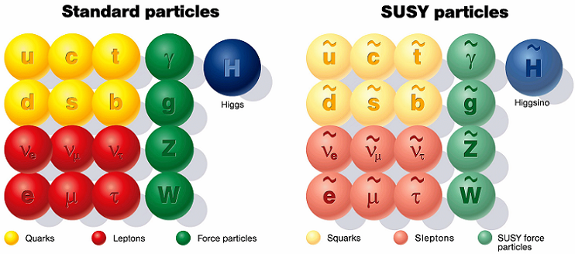
Minimal Supersymmetric Standard Model
Adds an additional symmetry (supersymmetry or SUSY) in nature between bosons and fermions
Each SM particle has a partner particle (sparticle) with same quantum numbers except spin differs by ½
Get cool names like sleptons, winos, sbottom
Consider R-parity conserving models today: sparticles are produced in pairs and decay to the lightest supersymmetric particle (LSP)

Slide 9
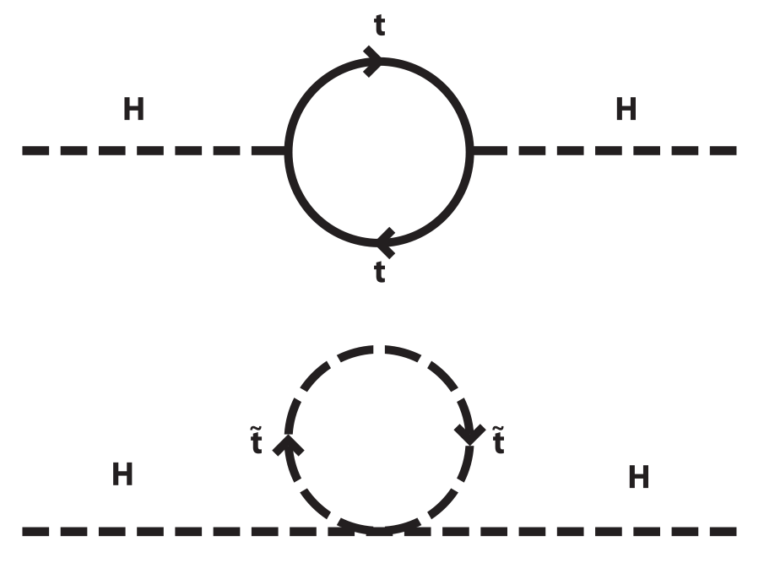
Three good features of SUSY
Can solve hierarchy problem: Quantum corrections from SM particles canceled by the sparticles.
Can provide a dark matter candidate. A neutral LSP will be a WIMP.
The strong, weak, and E&M forces have different strengths (couplings) that change (run) with energy. When the effects of SUSY are included, these couplings converge at 10¹⁶ GeV, keeping alive the hope for a Grand Unified Theory (GUT).

Slide 10
The less great features of SUSY
SUSY itself is a well defined theory.
If supersymmetry was a good symmetry, the sparticle masses would be the same as the particle masses.
Since we haven’t found any sparticles, there must be a symmetry breaking mechanism.
We have no idea how the symmetry breaking is done so this opens up all sorts of possibilities: 105 additional free parameters. These dictate the masses and decay patterns of the particles.

Slide 11
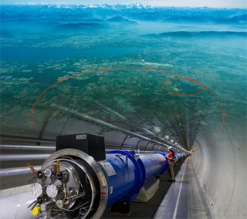
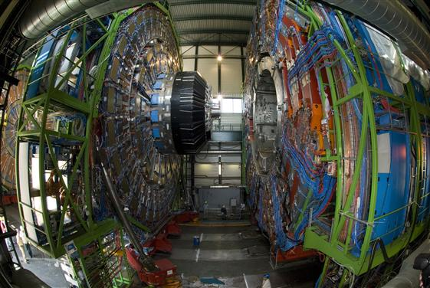
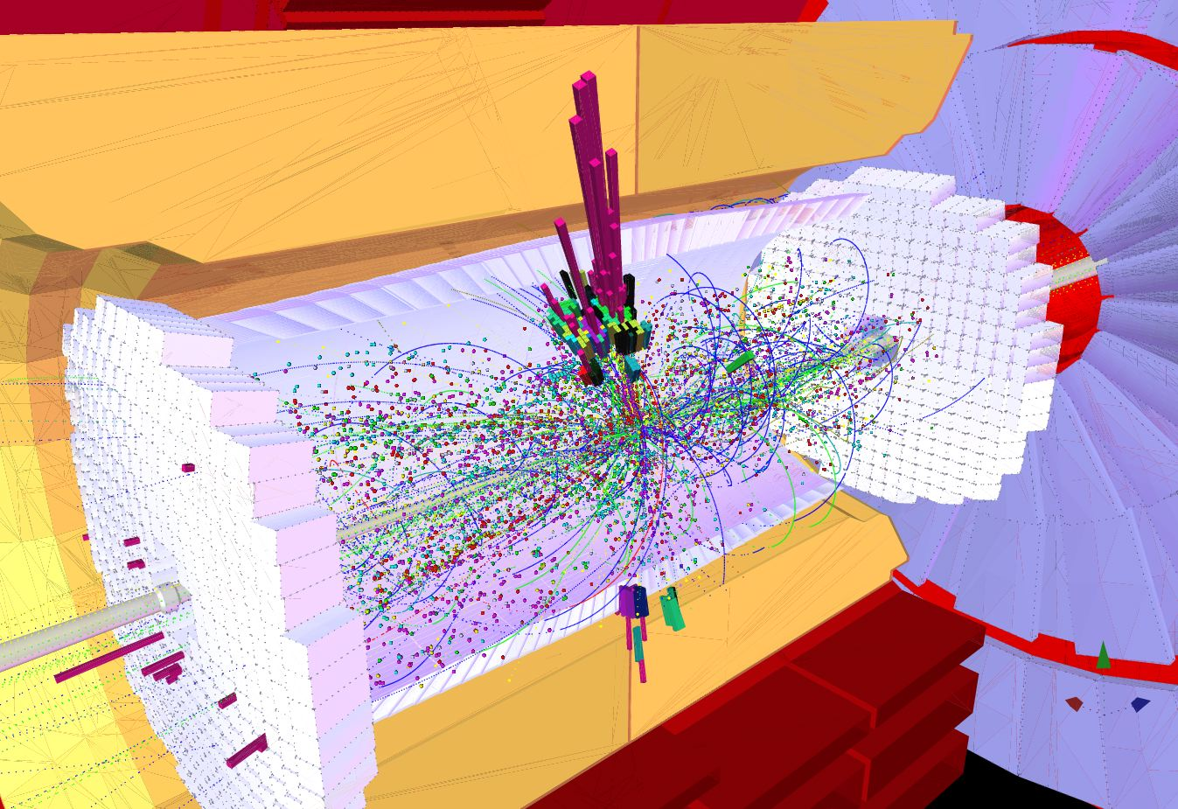
How do we look for new physics?
Need an accelerator to produce new particles.
Need a detector to record the production and decay of new particles.
Need to distinguish interesting events from SM events.

Slide 12
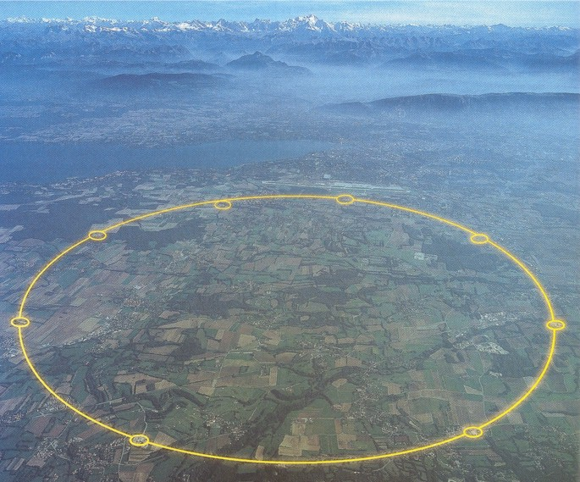
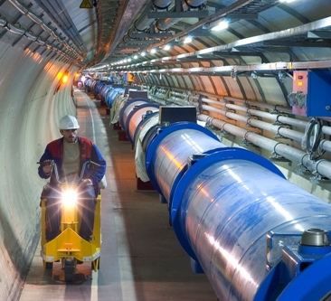
The Large Hadron Collider (LHC)
The Large Hadron Collider is 27 km long and 100-500 feet underground.
Alps
RF cavities accelerate protons to 0.99999999c
Geneva
8.3 T superconducting magnets keep the protons going in circles
Lake Geneva
Geneva airport
CMS

Slide 13
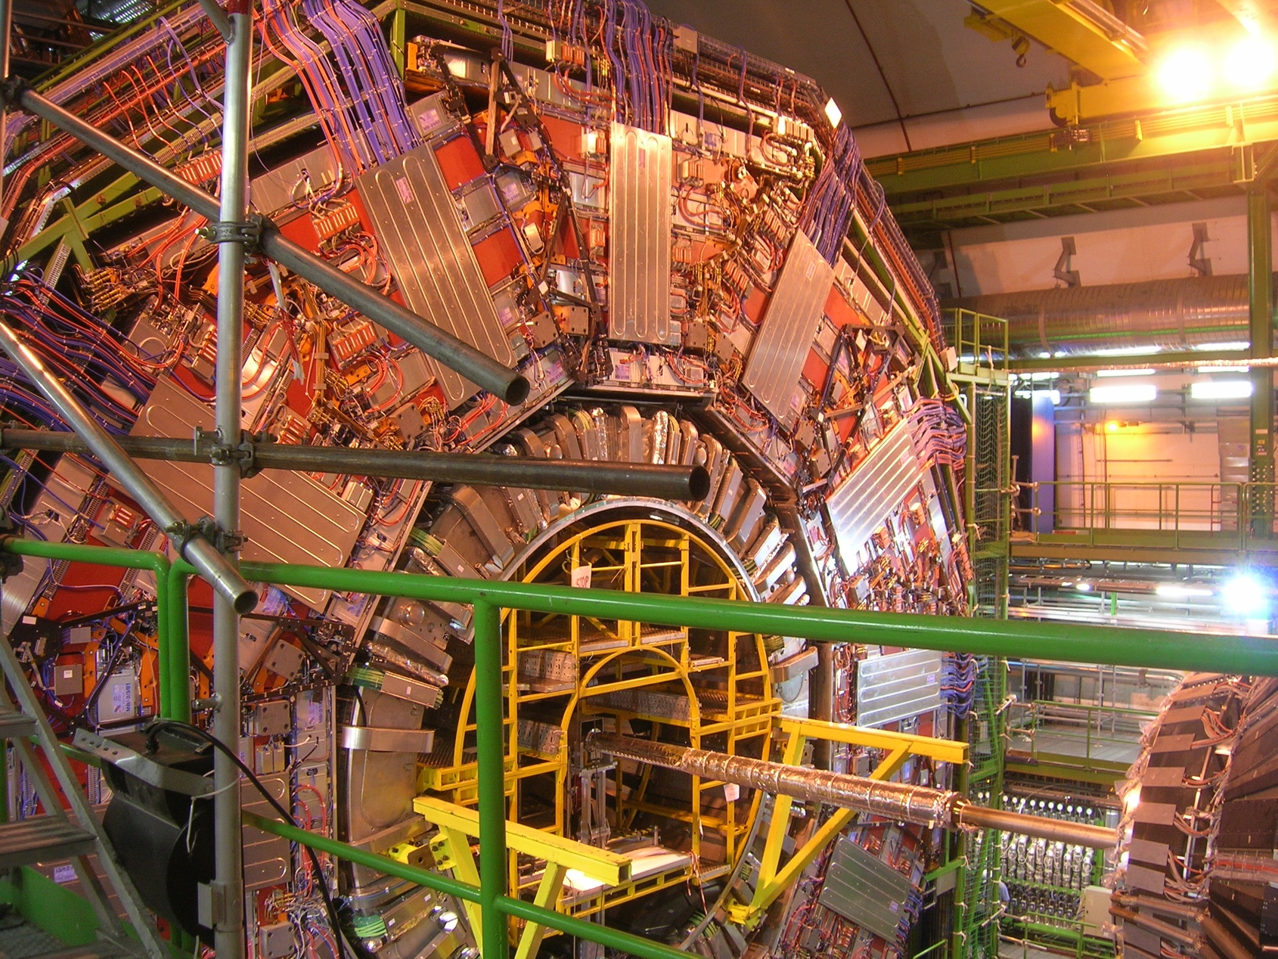
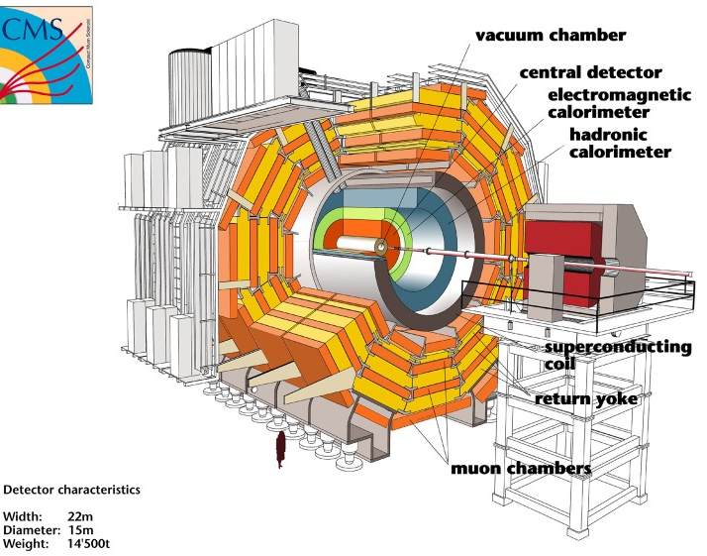
Detecting the particles
We collide protons at high energy to create new particles. But these particles immediately decay into other particles.
Need to detect these particles to reconstruct what happened.
The CMS detector is in a cavern 300 feet underground.

Slide 14
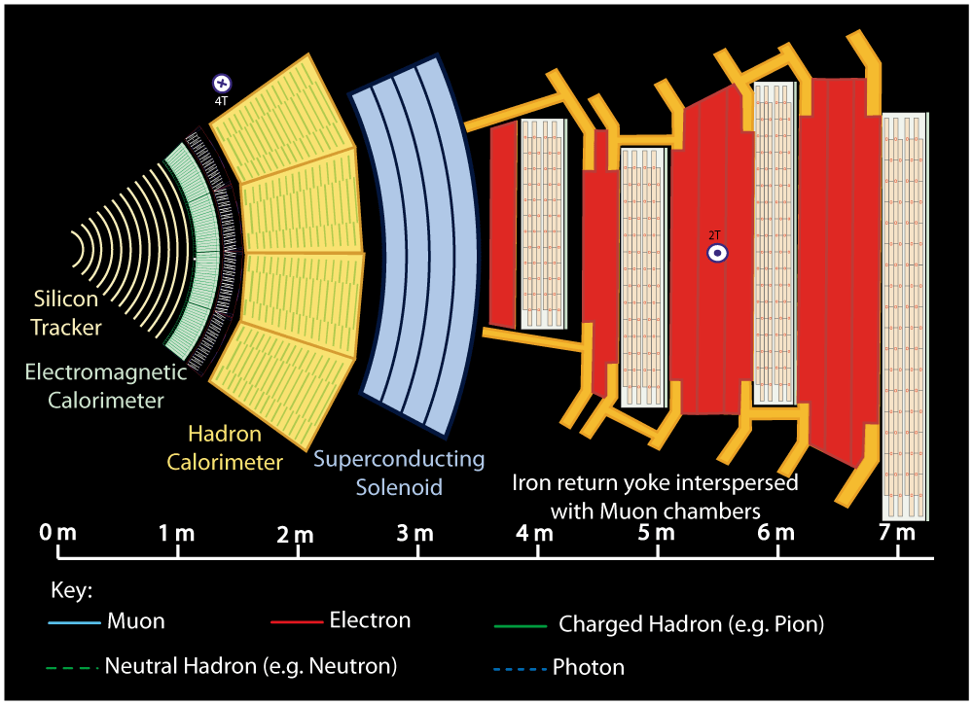

Slide 15
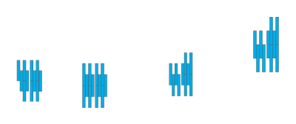



Slide 16
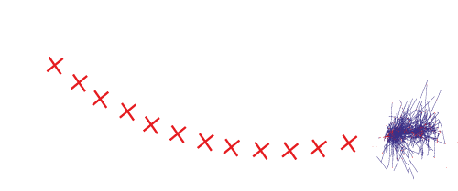



Slide 17
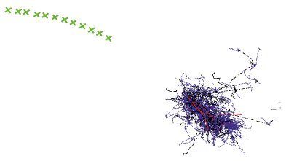



Slide 18
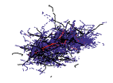


Slide 19




Slide 20
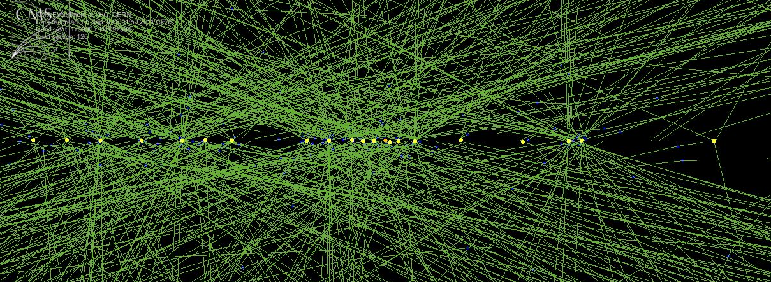
Event selection
Proton bunches collide 40 million times per second, which results in about 40 pairs of protons colliding.
It takes 1 MB of data to record an event.
So we would need to record 40 TB/second to get every event. Not feasible.
Instead, we look at a subset of the information to see if the event is interesting and only save it if it is. Save about 1000 events/sec leading to 10 PB/year.

Slide 21
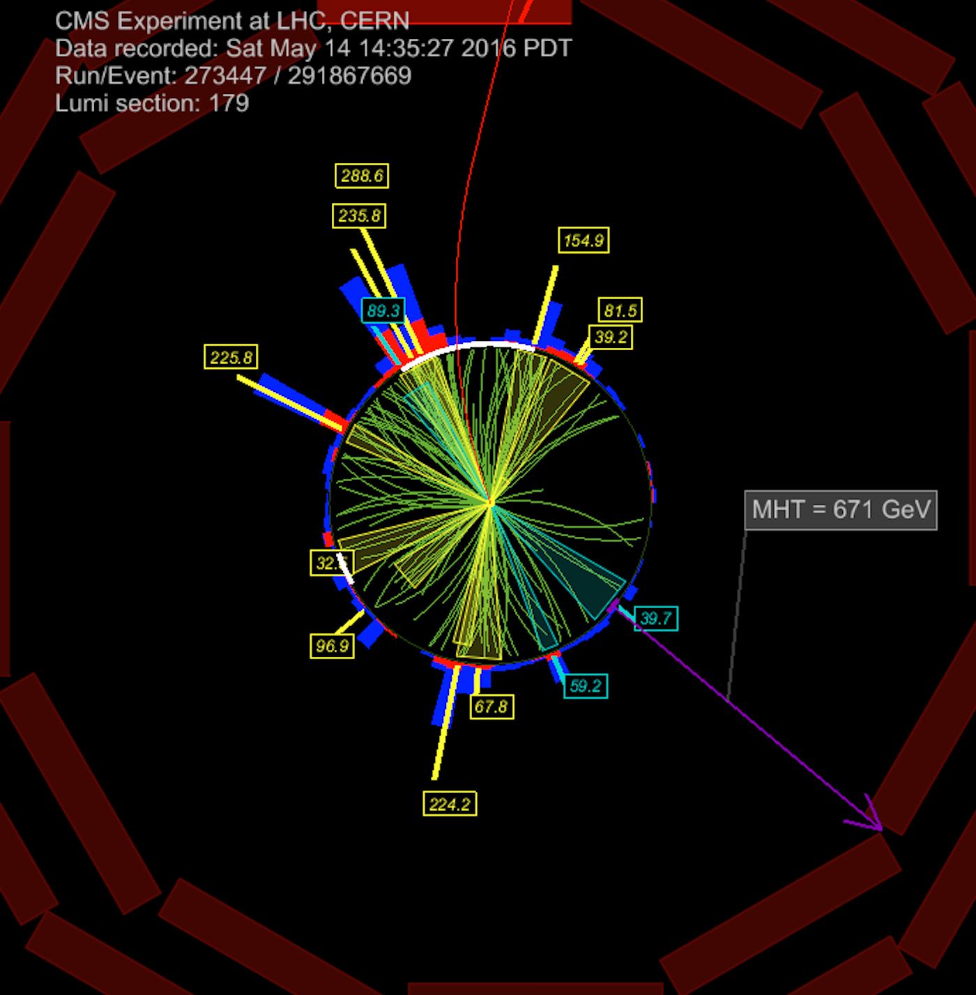
Possible SUSY event
This event contains 12 jets, 3 b-jets, and large amount of missing transverse energy. Great candidate for a SUSY event.
Jets come from the hadronization of quarks (and b jets from the hadronization of b quarks).
Missing transverse energy is the apparent imbalance of momentum after adding everything up.

Slide 22
Search for SUSY in hadronic modes
Search for SUSY involving production via the strong interaction (larger cross section) so produce gluinos or squarks.
Always have 2 LSPs (χ₁⁰) , which exit the detector undetected. In a hermetic detector, this can be seen as large missing transverse energy (MHT).
High mass events produce large amounts of energy seen in the detector (HT).
Each top quark decays to b quark (creating a b jet) and W boson (decaying to two jets 67% of time). Results in many jets (N_{jet}) and b jets (N_{b}).

Slide 23
SM backgrounds
QCD : Direct production of many jets with the energy of jet(s) mismeasured, leading to MHT.
Lost-lepton and hadronic τ :Production of W+jets where W decays to e/μ/τ and ν. Neutrino creates MHT. Reduced by rejecting events with e/μ/τ but some may slip through.
Z→νν : Production of Z+jets where Z decays to neutrinos, producing MHT.
These backgrounds are all estimated from data by using control regions (distinct from signal regions).

Slide 24
Signal region divided into bins
The HT-MHT plane divided into 10 bins.
4 bins of N_{jet}: 2, 3-4, 5-6, 7-8, 9+.
4 bins of N_{b}: 0, 1, 2, 3+.
Total of 174 bins.
New physics can show up in particular regions so binning increases the sensitivity and flexibility of the analysis.

Slide 25
Search results
Phys. Rev. D 96 (2017) 032003
Data consistent with estimated backgrounds. No sign of new physics.
Generic search for new physics.
This plus efficiencies are provided publicly for reinterpretation by theorists.

Slide 26
Limits on SUSY production
Phys. Rev. D 96 (2017) 032003
Simplified Models: Assume a small number of SUSY particles participate with specific decay modes. Can calculate cross sections for these models in terms of one or two masses.
Place limits on maximum cross section in 2D space of LSP mass and gluino mass.
Use calculated cross sections to determine what masses are excluded.

Slide 27
A few other simplified model limits
Phys. Rev. D 96 (2017) 032003

Slide 28
Can even search using Higgs decays
Phys. Rev. Lett. 120 (2018) 241801
Search for high-momentum Higgs decaying into two b jets.
Place limits on gluino mass in this particular scenario.

Slide 29
CMS limits on gluino masses
Limits on the gluino mass from a variety of CMS searches.
Exclude masses below 1–2 TeV depending on mode.
Generally represent the maximum possible excluded mass.

Slide 30
CMS limits on squark masses
Limits on squark masses from CMS searches.
Excluded masses range from 0.5–1.5 TeV.
Generally represent the maximum possible excluded mass.

Slide 31
CMS limits on electroweak production
Gluino and squark production should have highest cross sections but maybe have high mass and can’t be produced.
Can look for production via electroweakinos.
Smaller mass limits as cross sections are smaller.

Slide 32
Where do we stand with SUSY?
Two common ways to simplify the SUSY parameter space:
  Constrained MSSM (CMSSM) makes strong assumptions about universality at the GUT scale and how SUSY is broken. Some constraints not well justified. Has 4 parameters plus a sign.
  Phenomenological MSSM (pMSSM) removes CP violating phases and sets some masses equal. About 7–19 free parameters.
Can construct likelihood function as a function of SUSY parameters incorporating measurements from LHC, LEP, dark matter searches, cosmology, etc. to see what parameters are still viable.

Slide 33
Results of 11-parameter pMSSM fit
arXiv:1710.11091
The addition of LHC data at 13 TeV has significantly constrained the allowed region.
LSP vs gluino mass shows wide ranges still possible.

Slide 34
Results of 11-parameter pMSSM fit
arXiv:1710.11091
Cross section vs mass of dark matter particle. Future direct dark matter searches can reduce allowed space.
The addition of LHC data at 13 TeV has significantly constrained the allowed region.

Slide 35
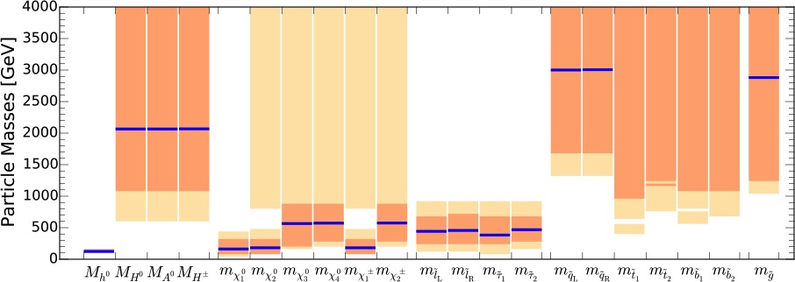
Where do we stand with SUSY?
SUSY can provide the dark matter in the universe with a wide range of mass possibilities.
Can it still solve the hierarchy problem?
  Many discussions about what counts as “fine-tuning”.
  From arXiv:1407.6966, the strongest constraint on keeping fine tuning below 1% is that the gluino mass is <1.5 TeV (but this limit loosens to 2.5 GeV if new physics is at 10⁷ GeV rather than the GUT scale).
  OK so far
arXiv:1710.11091

Slide 36
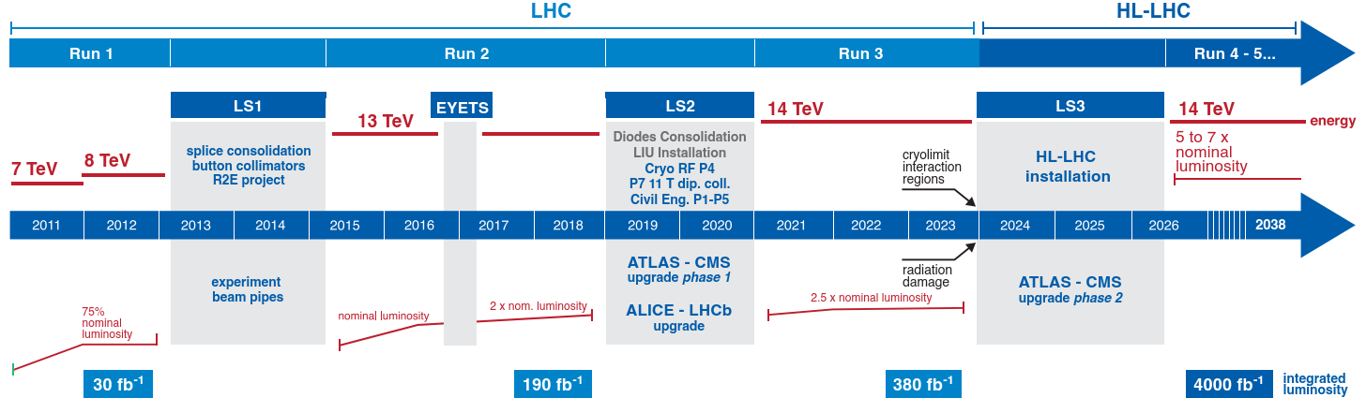
Where do we go from here?
Collect more data
  Currently analyzing 135 fb⁻¹ (about 3 times more).
  Expect to have 300 fb⁻¹ by end of 2023.
  HL-LHC from 2026–2036 should produce additional 3000 fb⁻¹.
Perform targeted searches in difficult to access areas, usually due to low missing transverse momentum.
  Compressed SUSY: small mass splittings of the sparticles.
  Stealth SUSY: hidden sector and partner masses near SM masses.
  R-parity violating SUSY: allows sparticles to decay to SM particles.

Slide 37
Challenges of the HL-LHC
Proton bunches collide every 25 ns. Multiple protons collide each time (pileup). Designed for pileup=25, currently at pileup=40, and HL-LHC plans for pileup=200.
Need to move as much of offline reconstruction as possible into the trigger (which selects the events to keep).

Slide 38
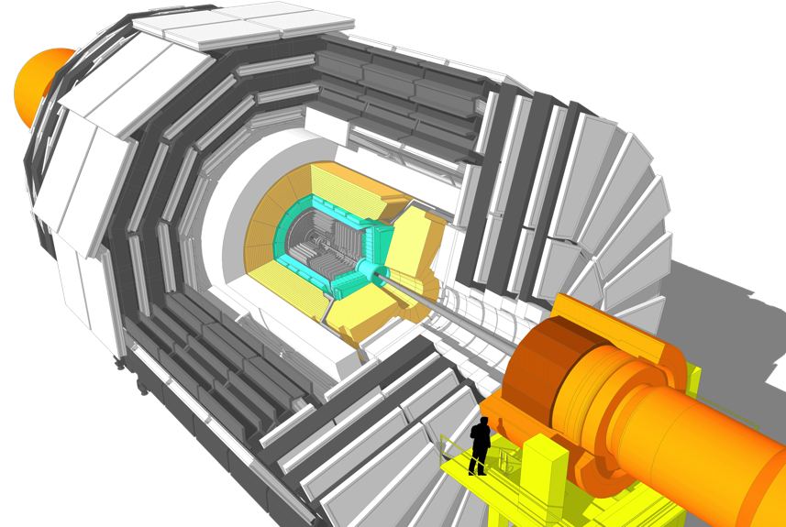
CMS HL-LHC Upgrade Overview
Trigger/HLT/DAQ
Track information in trigger at 40 MHz
12.5 µs latency
HLT input/output 750/7.5 kHz
Barrel Calorimeter
New FE/BE electronics for full granularity readout at 40 MHz – with improved time resolution
Lower ECAL operating temperature
Muon systems
New DT & CSC FE/BE electronics
New station to complete CSC at 1.6 < η < 2.4
Extended coverage to η ≃ 3
New Endcap Calorimeters
Rad. tolerant - High granularity transverse and longitudinal
4D shower measurement including precise timing capability
New Tracker
Rad. tolerant - increased granularity - lighter
40 MHz selective readout (strips) for Trigger
Extended coverage to η ≃ 3.8
MIP precision Timing Detector
Barrel layer: Crystal + SiPM
Endcap layer: Low Gain Avalanche Diodes
Notes:
Circle your part of the upgrade

Slide 39
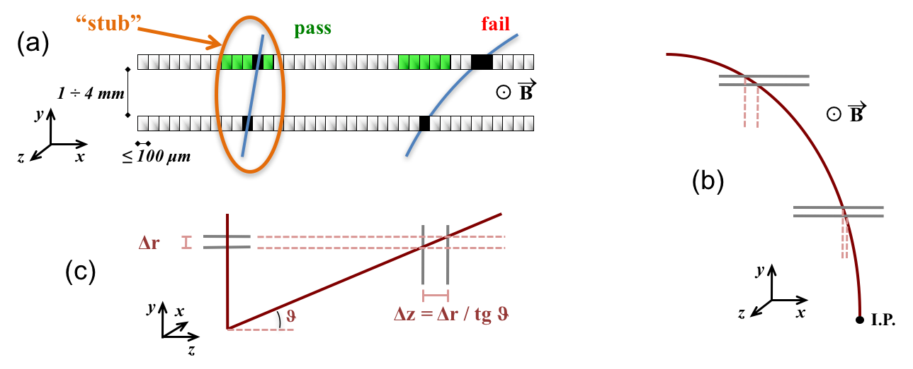
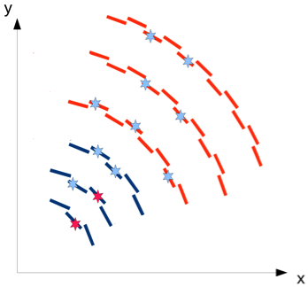
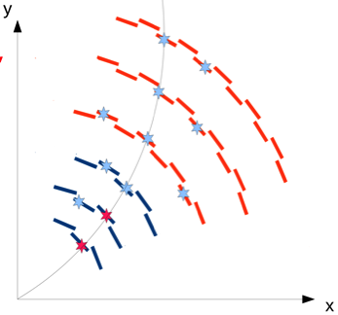
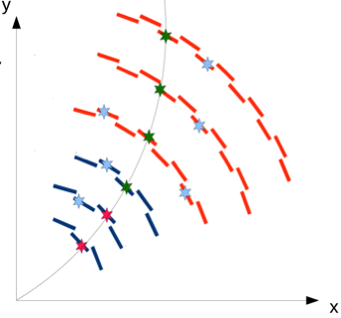
Track trigger at Level 1
Need to reconstruct tracks in 4μs (rather than >10s on CPUs).
Tracker with double layers to only select hits with p_{T} > 2 GeV.
Process hits in FPGA on Track Finder boards to reconstruct and output the tracks.

Slide 40
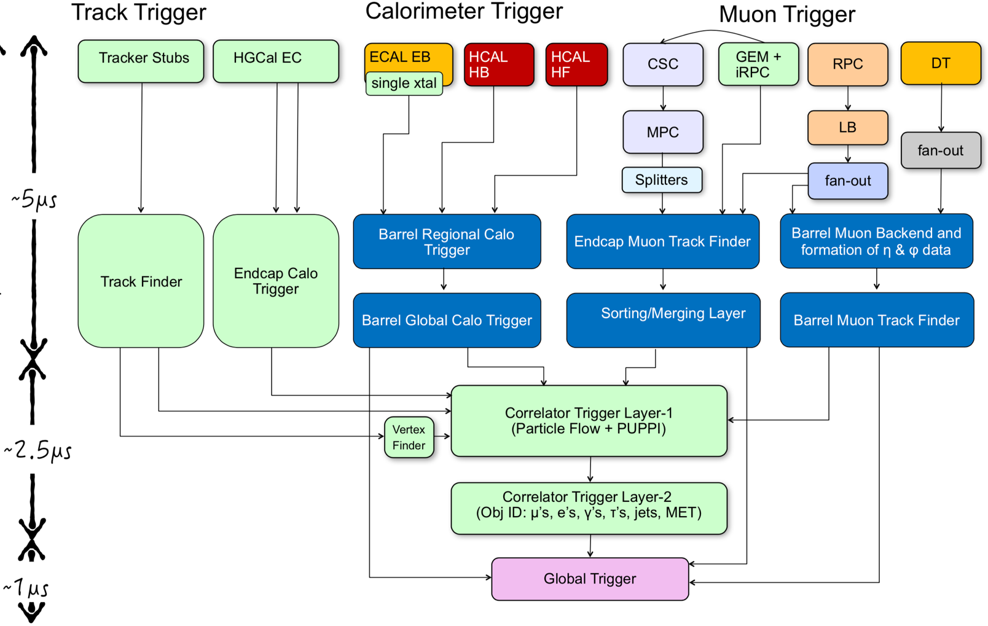
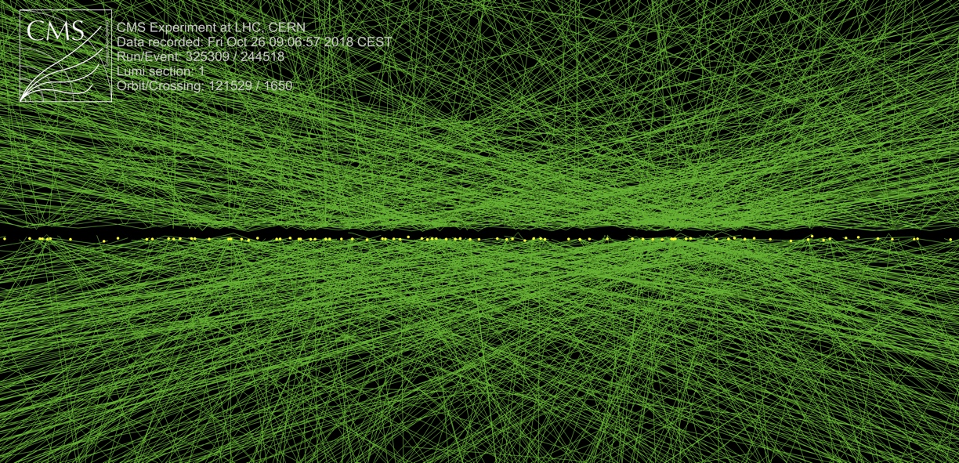
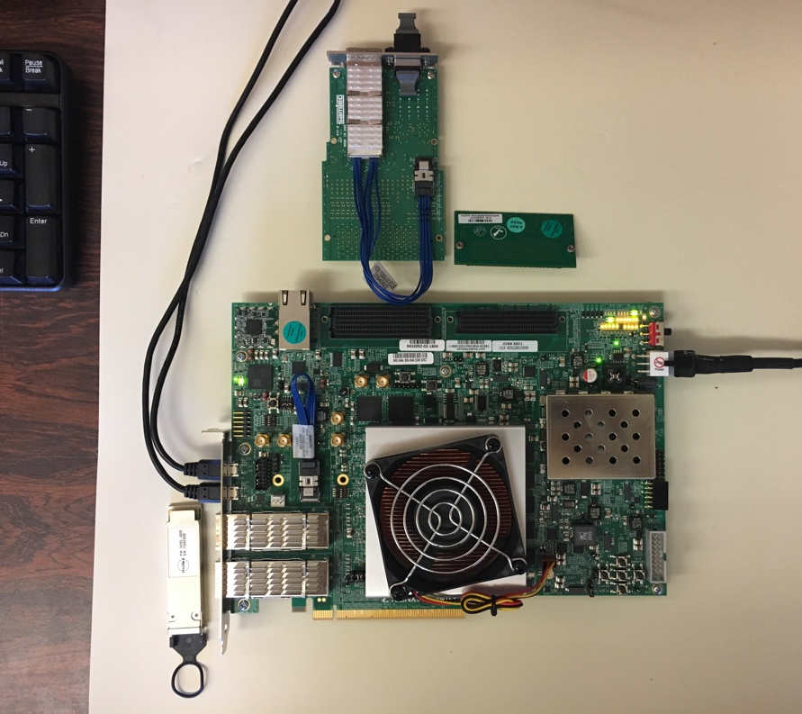
HL-LHC trigger system
Vertex finder board takes tracks and finds the vertex of interest and other quantities.
Firmware now being developed on test board at CU.
Correlator takes information from the entire detector and attempts to identify all particles from the vertex of interest. Working on the architecture of this system.

Slide 41
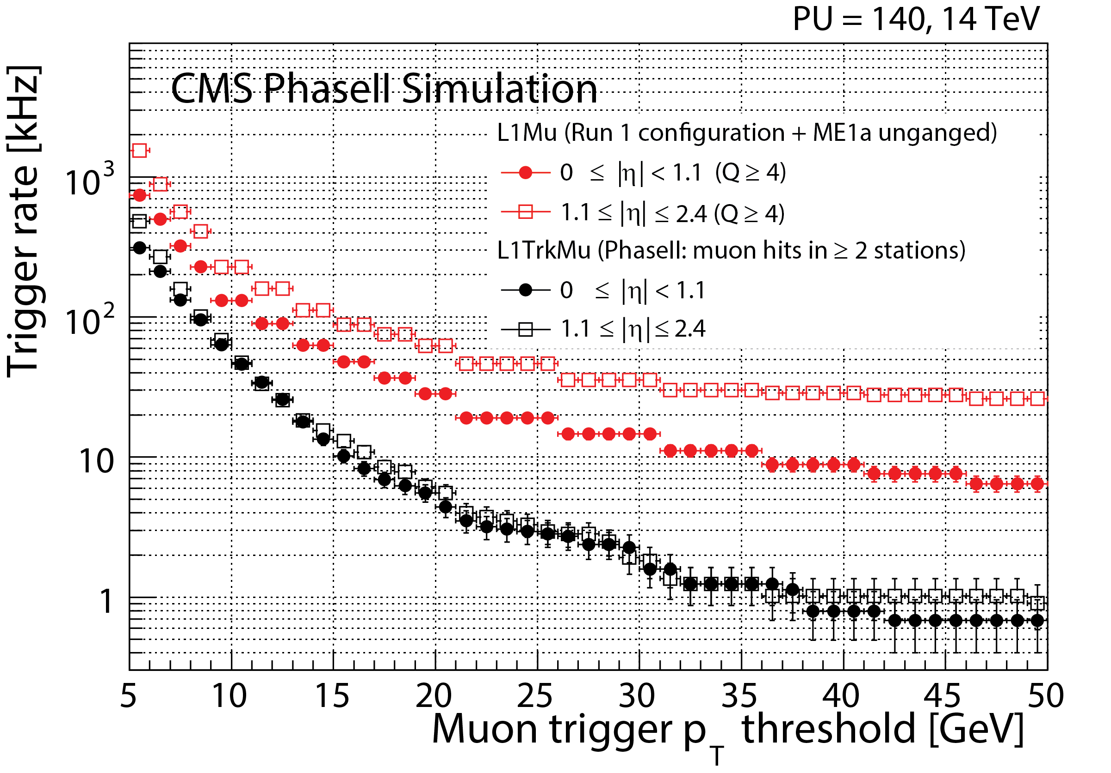
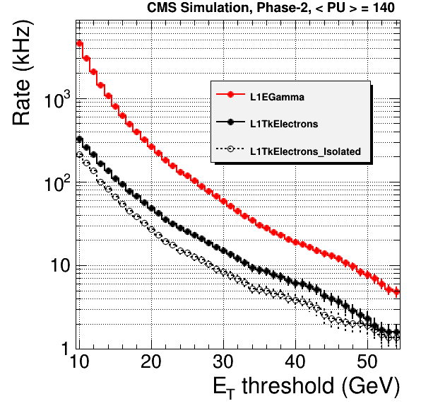
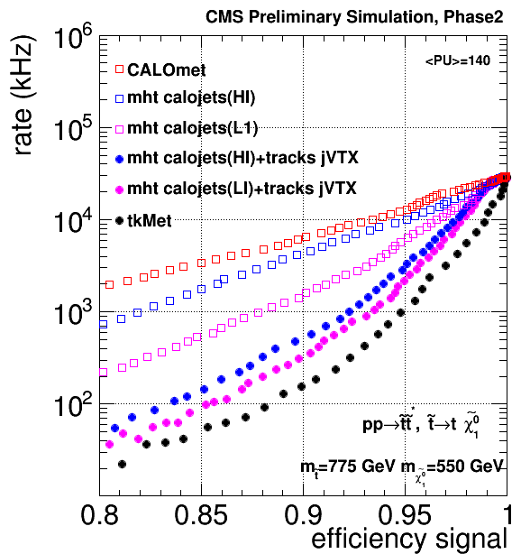
HL-LHC trigger results
Better momentum resolution reduces muon rate by factor >10.
Electron rates reduced by nearly factor of 10.
Main trigger for SUSY searches allows for high efficiency with reasonable rate.

Slide 42
SUSY searches at HL-LHC
Example of improvement in discovery range for electroweak production.
Summary of discovery potential for a few SUSY possibilities.

Slide 43
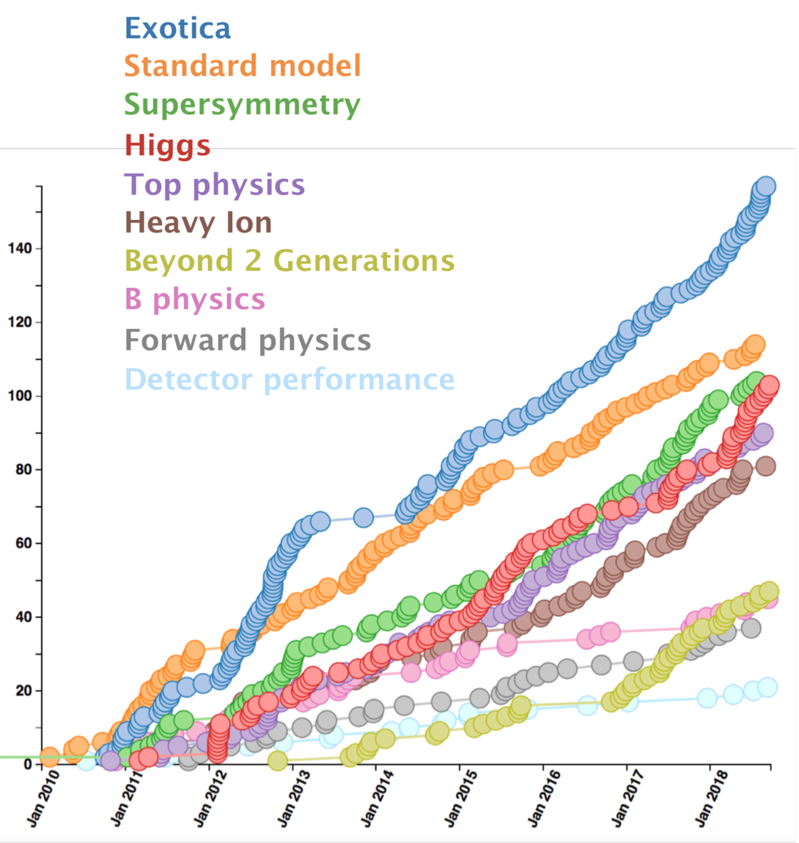
Summary
The search for physics beyond the Standard Model is proceeding at a rapid pace.
CMS is looking for any deviations from the Standard Model to find the way forward.
CMS publications
Constraints on supersymmetry also come from other areas such as searches for dark matter and the electric dipole moment of the electron, and measurements of b-hadron decays and the anomalous magnetic dipole moment of the muon.
There is still hope for new physics from the LHC.

Slide 44
Backup

Slide 45
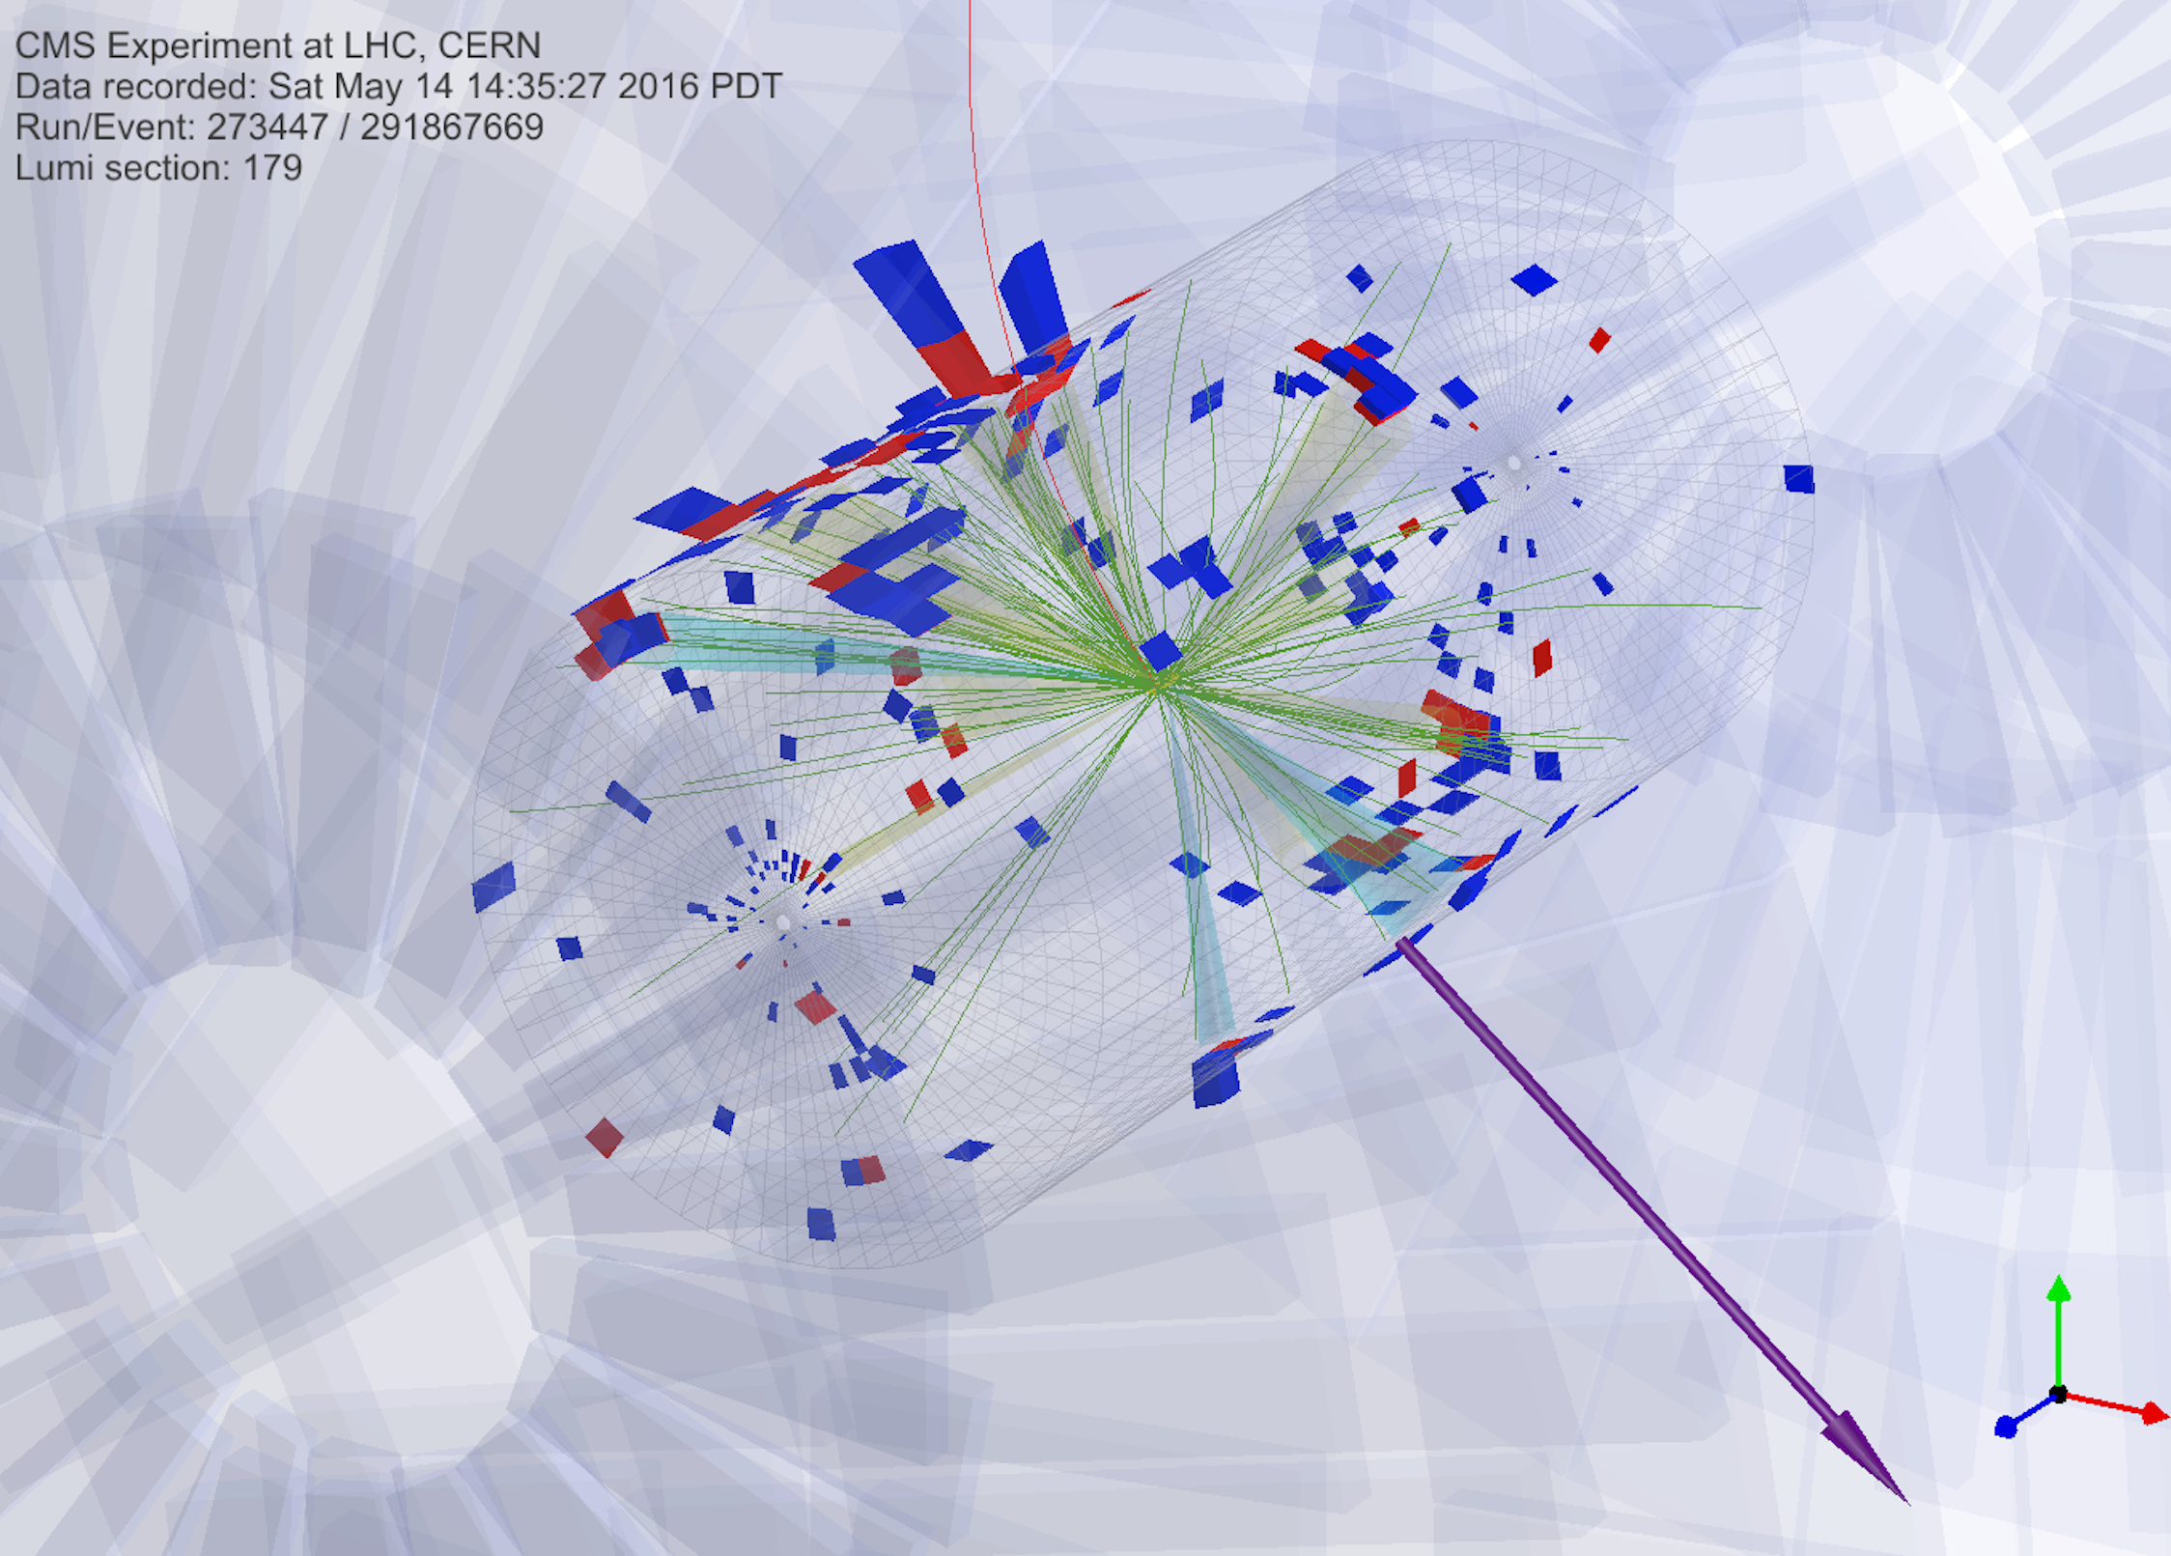
Possible SUSY event
This event contains 12 jets, 3 b-jets, and large MHT.

Slide 46
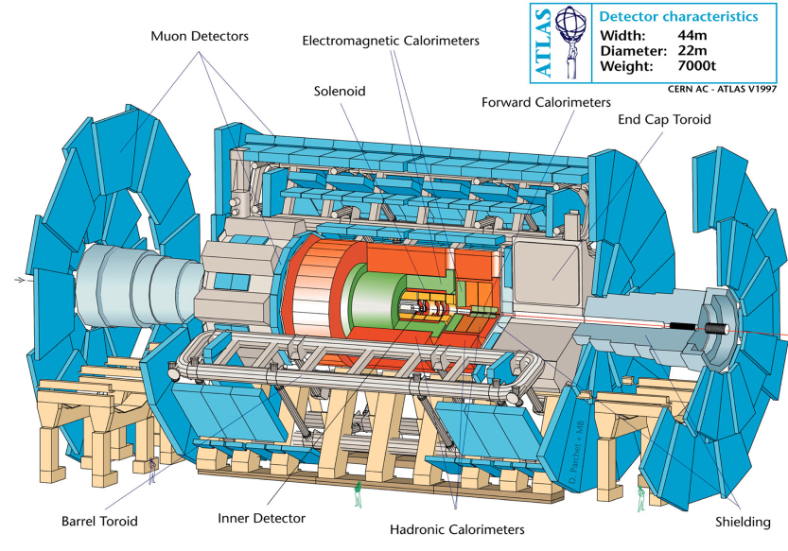
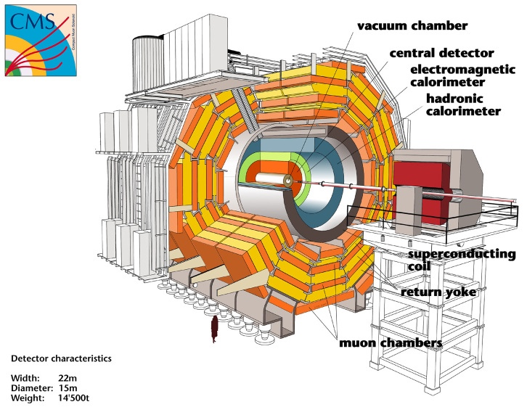
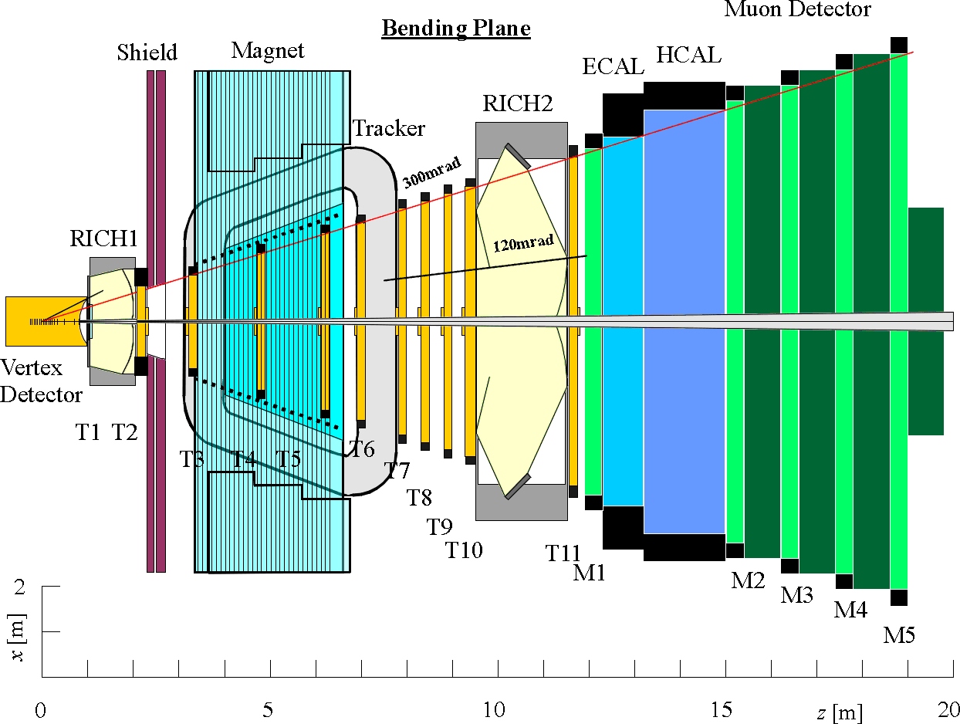
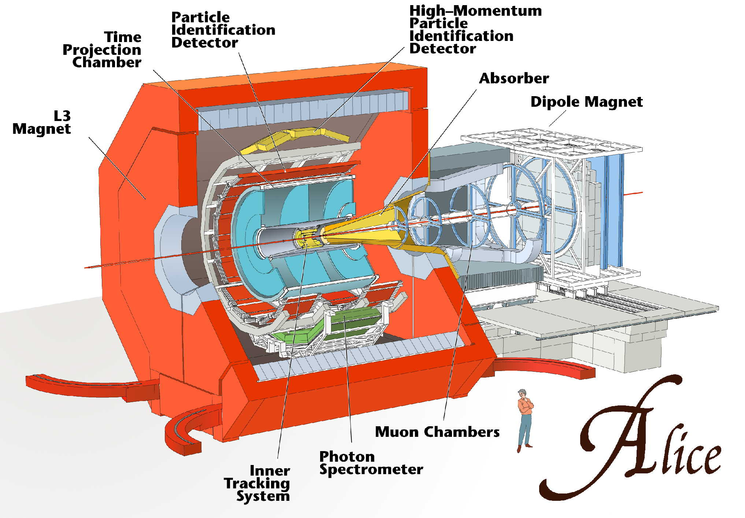
The LHC detectors
LHCb

Slide 47
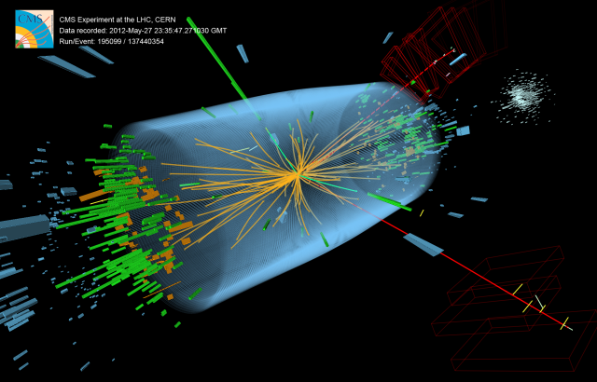
Possible Higgs decay: H→ZZ→ee𝜇𝜇

Slide 48
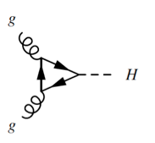
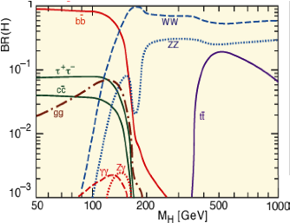
Higgs production and decay
Two gluons inside the colliding protons fuse to make a Higgs boson.
The Higgs is unstable so it decays into other particles, some of which also decay.
  H→𝛾𝛾 and H→ZZ are the most important.

Slide 49
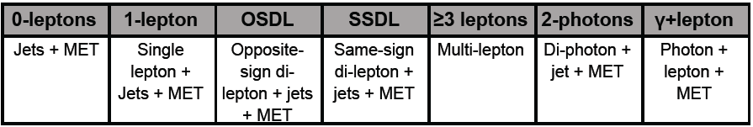
Searching for supersymmetry
A few rules for most SUSY searches:
squarks and gluinos are predominantly produced because they couple to the strong force
SUSY particles produced in pairs (R-parity conservation)
Decay cascades end with lightest supersymmetric particle (LSP) which escapes detection.
  Cascades produce jets & leptons (electrons, muons, taus)
  The escape of LSP’s results in missing energy (MET).
These rules suggest search strategies:

Slide 50
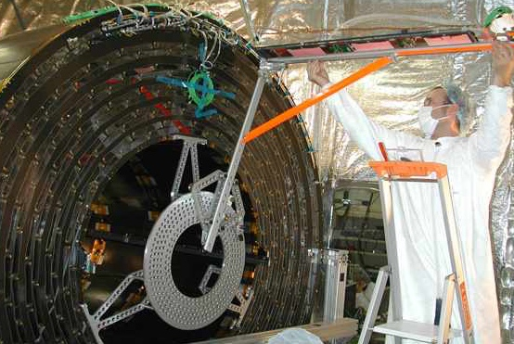
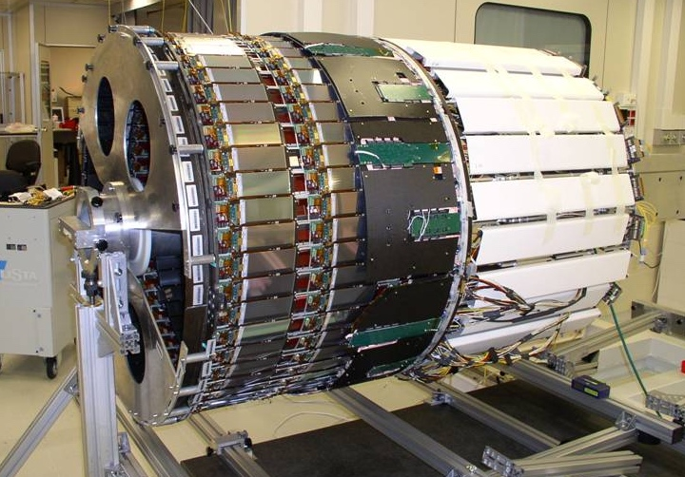
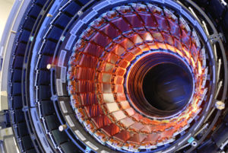
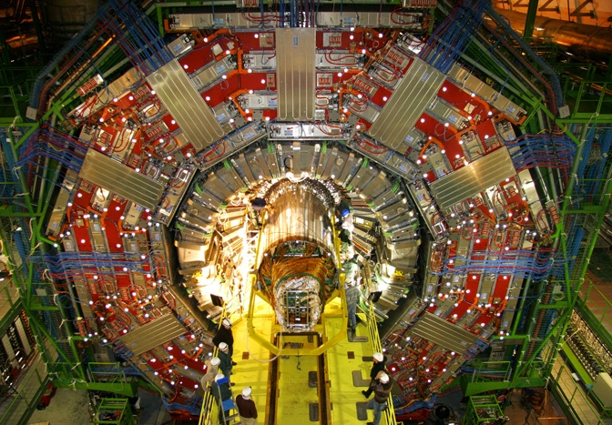
CMS Tracker
Goes inside
CMS tracker uses 2300 square feet of silicon detectors.
CMS tracker being inserted into CMS

Slide 51
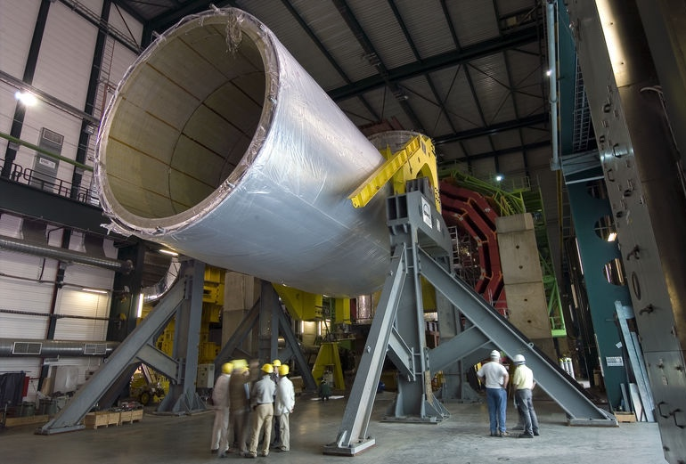
CMS Solenoid
3.8 tesla magnet at 4 K
6 m diameter and 12.5 m long (largest ever built)
220 t (including 6 t of NbTi)
Stores 2.7 GJ — equivalent to 1300 lbs of TNT
If magnet gets above superconducting temperature, energy is released as heat – need to plan for the worst
Bends charged particles allowing tracker to measure momentum

Slide 52
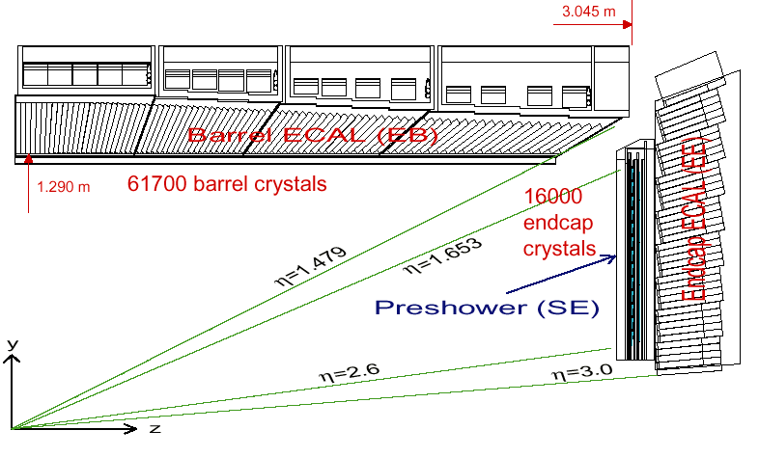

CMS Electromagnetic Calorimeter (ECAL)
Photons and electrons shower in high Z material
Homogenous calorimeter
Lead tungstate (PbWO₄) crystals: 2.3 x 2.3 x 23 cm³
Radiation hard, dense, and fast
Low light yield & temperature sensitivity make it difficult
Magnetic field and radiation require novel electronics APD and VPT

Slide 53



CMS Hadronic Calorimeter (HCAL)
Sampling calorimeter
Brass absorber from Russian artillery shells (non-magnetic)
Scintillating tiles with wavelength shifting (WLS) fiber
WLS fiber is fed into a hybrid photo-diode (HPD) for light yield measurement

Slide 54


CMS Muon detector
Muons interact less than other charged particles
Place detectors after lots of material so that what comes through must be a muon
Add magnetic field & tracking to find momentum and link with main tracker
12000 t of iron is absorber and solenoid flux return
Three tracking technologies: Drift Tube, Resistive Plate Chamber, & Cathode Strip Chamber

Slide 55
Search results
Can look in the more sensitive regions to see what a signal may look like.
Still no sign of SUSY.

Slide 56
Limits from hadronic SUSY search

Slide 57
Dark Matter candidates

Slide 58

Dark matter cross section vs mass
arXiv:1401.6085

Slide 59
Axion limits
Safdi at IDM 2018

Slide 60
WIMP limits
arXiv:1707.06277

Slide 61
Results of 11-parameter pMSSM fit
arXiv:1710.11091
The masses and decays for the best fit.
The range of masses allowed.

